Slide 1
Project 1
The Impact of Hard Drug Use on HAART Treatment Response
​
Statistician: Shuai
​

Slide 2
Introduction
Dataset: 715 HIV-infected men from the Multicenter AIDS Cohort Study (MACS), with data collected over 8 years.
Research Aim: Examine how hard drug use at baseline affects Highly Active Antiretroviral treatment responses two years later.
Treatment responses: Viral load, CD4+ T-cell count, physical and mental quality of life scores.

Slide 3
Data cleaning
Baseline body mass index (BMI) values that greater than 200 or less than 0 were treated as missing.
BMI at baseline was categorized as underweight (BMI < 18.5 kg/m²), normal weight (18.5 ≤ BMI < 25 kg/m²), overweight (25 ≤ BMI < 30 kg/m²), and obese (BMI ≥ 30 kg/m²).
Education levels at baseline was recategorized into three levels: "High school or less," “Bachelor’s degree or college," and "Graduate or post-graduate degree”​
Adherence to HAART was dichotomized, with values above 95% considered adherent and values below 95% considered non-adherent.
Observations with complete cases were retained, reducing the sample size to 425.

Slide 4
Model
Frequentist Approach:
Multivariable linear regression models were built for each outcome.
Adjustments for baseline treatment response, age, BMI, education, and adherence.
Model diagnostics included checks for independence, linearity, homoscedasticity, and normality.
Bayesian Approach:
Used non-informative(N(0,10^7)) and vague priors (N(0,10^6)).
Priors for beta coefficients and model error were specified.
Inference conducted via Markov Chain Monte Carlo (MCMC) sampling, with 2,000 iterations and 4 chains per model.
Posterior distributions were summarized with mean and credible intervals for parameter estimates.

Slide 5
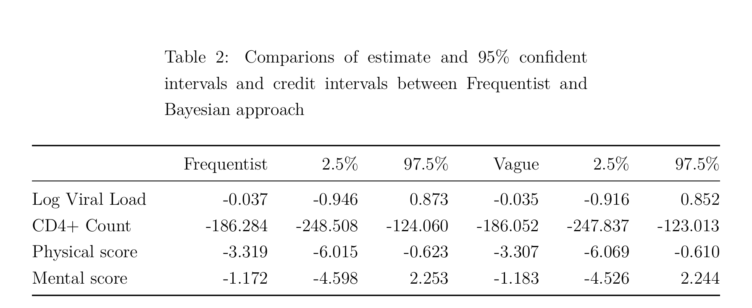
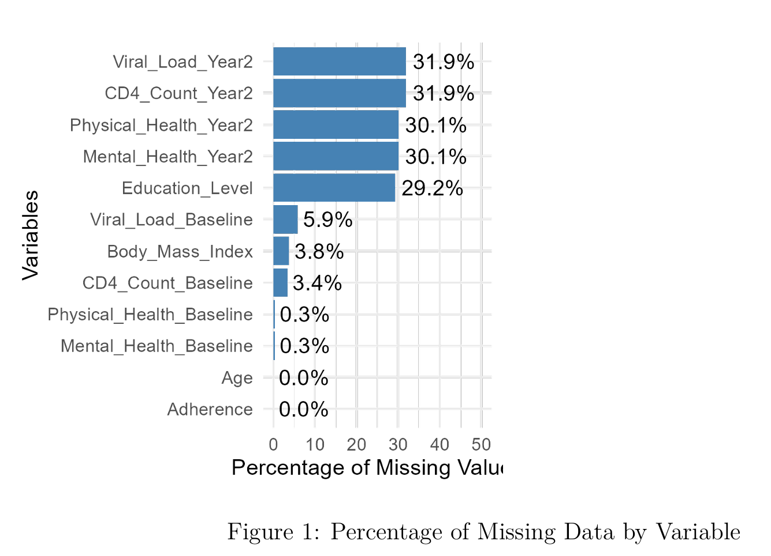
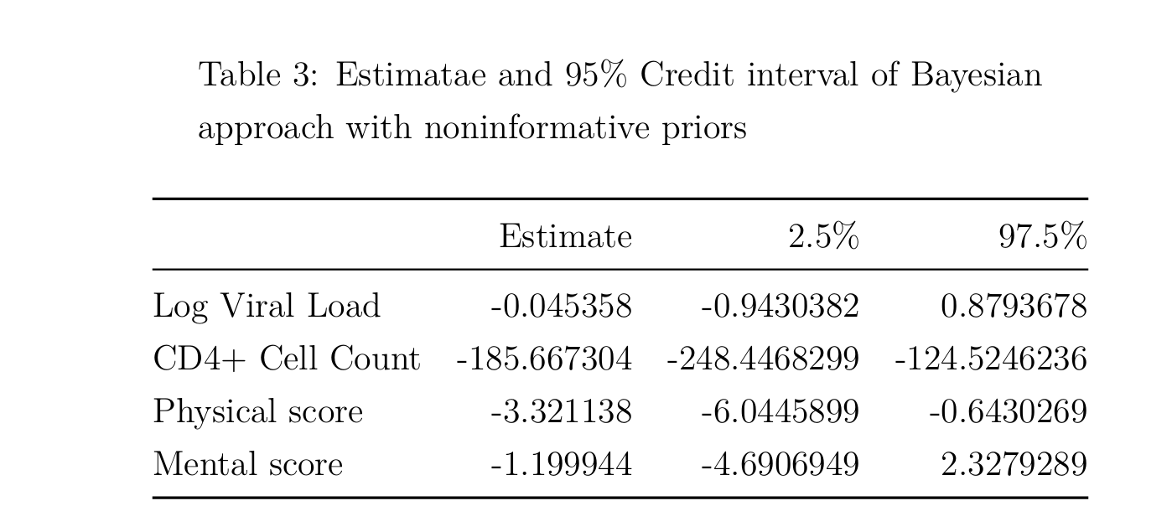
Results

Slide 6
Conclusion
The analysis found no significant differences in viral load or mental quality of life between participants who reported hard drug use at baseline and those who did not.
However, hard drug users had significantly lower CD4+ T-cell counts and physical quality of life scores compared to non-users.
Limitation: small proportion (8.2%) of participants who reported hard drug use.

Slide 7
suggestion
State hypothesis

